Slide 1

Car Price Prediction Project
Chaganti sai mahathi

Slide 2
Abstract:
Cars are being sold more than ever. Developing countries adopt the lease culture instead of buying a new car due to affordability. Therefore, the rise of used cars sales is exponentially increasing. Car sellers sometimes take advantage of this scenario by listing unrealistic prices owing to the demand. Therefore, arises a need for a model that can assign a price for a vehicle by evaluating its features taking the prices of other cars into consideration, supervised learning method namely Random Forest is used to predict the prices of used cars.

Slide 3
BUSINESS GOAL
It is required to model the price of cars with the available independent variables. It will be further used and also helps to understand how exactly the prices vary with the independent variables. They can accordingly manipulate the design of the cars, the business strategy etc. to meet certain price levels.

Slide 4
Steps to Process EDA:
1
Import all the necessary Libraries.
Load the dataset.
2
Checking the null values and null count of each column in the given dataset- No Null count.
Data Visualization using bar graph.
3
Encoding the data.
Checking Outliers and Skewness.
getting the data dimension - (4635, 10)
Data type of each column of the data frame is given below.
Getting the value counts of each column of the data frame.
Describing the dataset.
Checking the correlation.
Feature Selection Process.
Creating a Desired model.

Slide 5
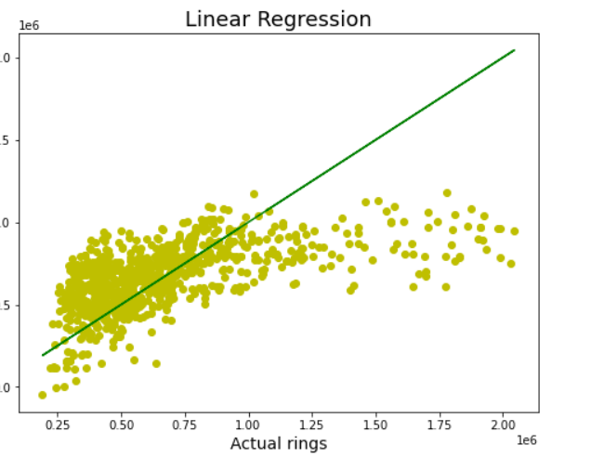
Model Building:
Linear Regression Model:
linear regression model to test the data the r2 score of the predicted data is given as 0.33.
Once the model is linearly regressed then use lasso regularization technique to get the maximum best output-0.33952.
Using the best cross validation score we get the output for this model as
0.3028

Slide 6



Hyper Parameter tuning using Ensemble approaches:
RandomForestRegression:
DecisionTreeRegression:
KNeighborsRegression:
Out of which Random forest regression model considerably best model and this model is saved for the future prediction.

Slide 7
SUGESSTIONS AND INSIGHTS
Cars Range is one of the most significant variables for deciding price. Hence, the company should select their price range within 18500$ to 30000$ initially.
Fuel Economy of the car is very important for the customers these days. The company should make sure the fuel economy of cars is not less than 5 litres/100km.
The company should make sure to have cars with drive wheel ‘rwd’ because people prefer it despite its high price.
Most of the cars should have petrol fuel type, because people prefer petrol way more than diesel.
Most people prefer convertible despite its price range being medium-high. Hence, company should focus on this as well.

Slide 8


